Slide 1

DGMD S-14 Wearable Devices and Computer Vision
Stride Classification
Martin Stack
Rafael Hernandez

Slide 2
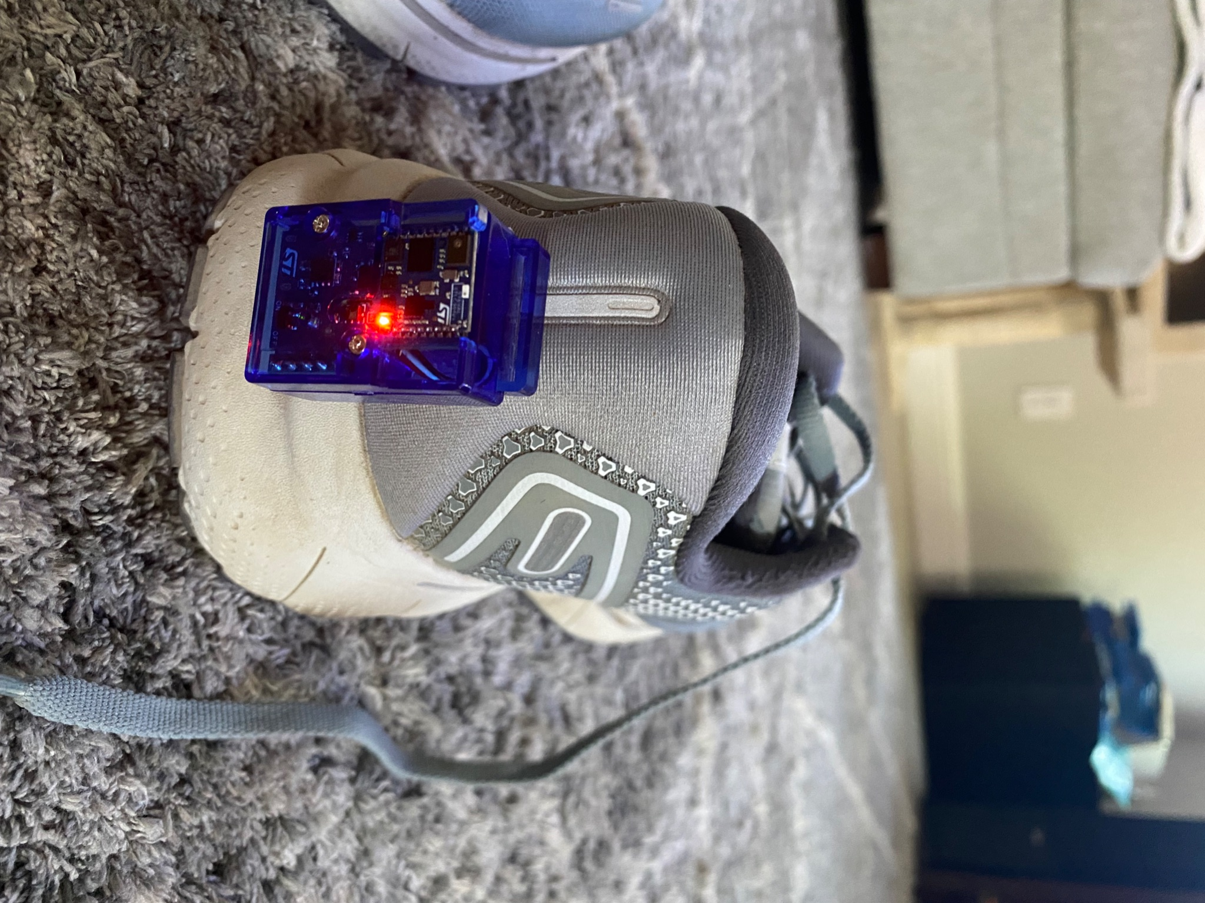
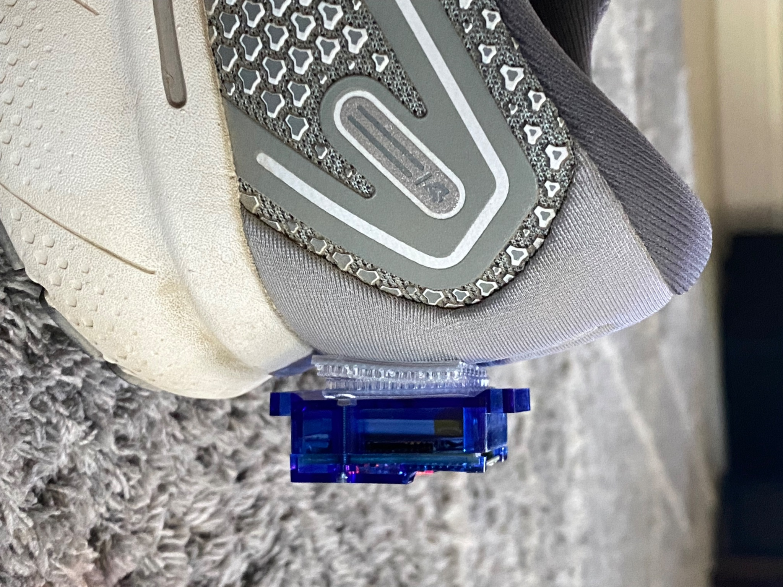
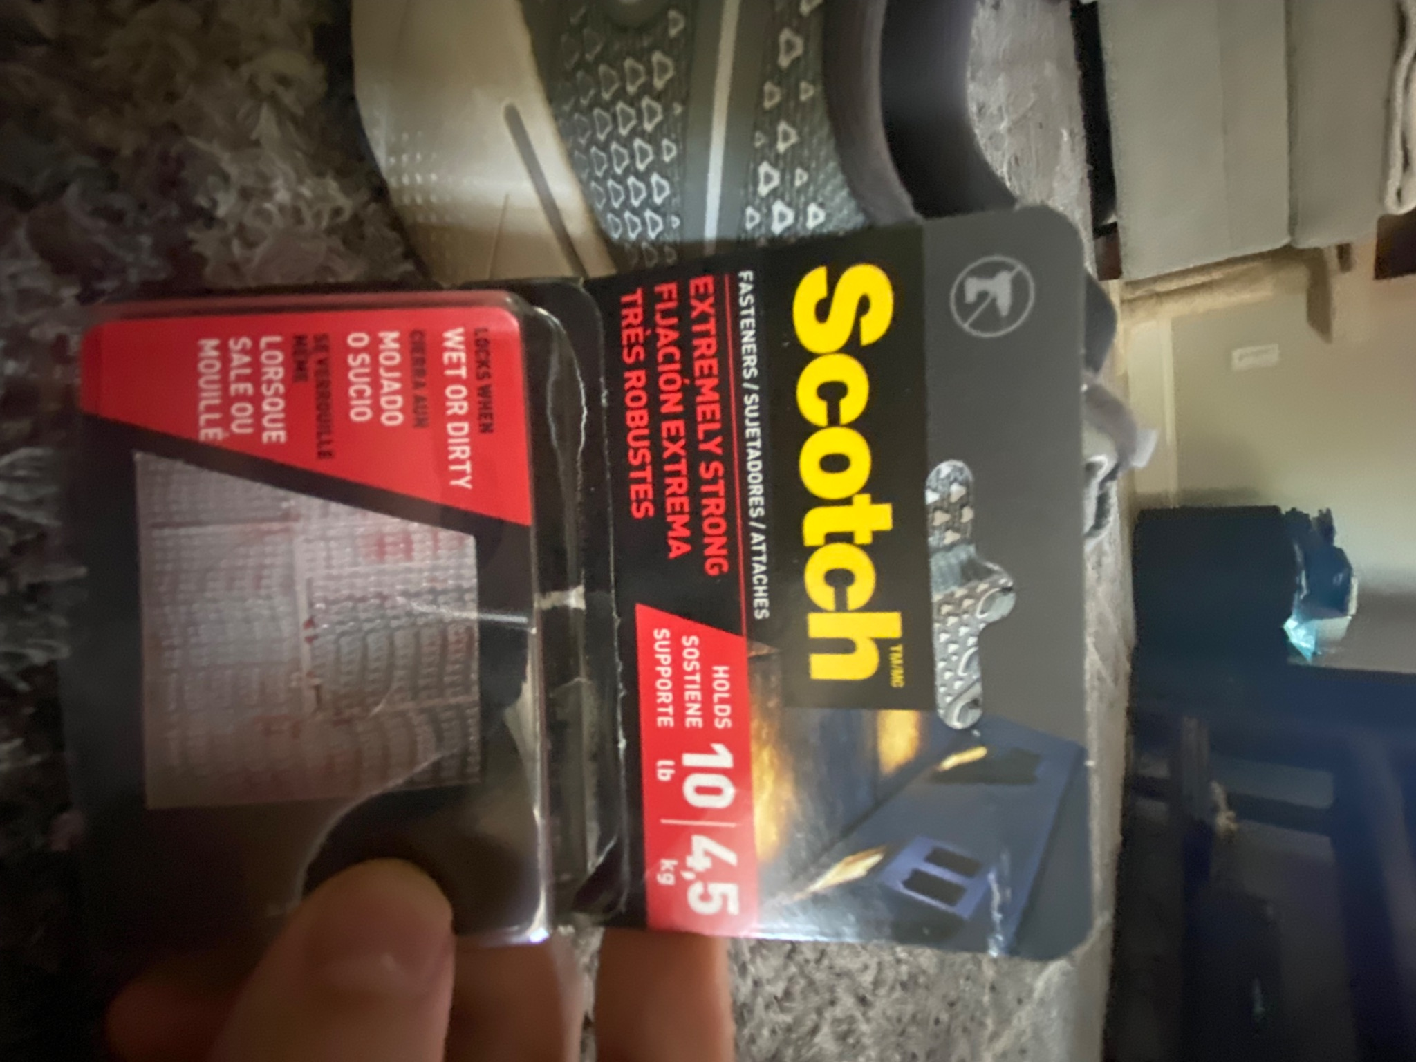
Sensor Tile Placement

Slide 3
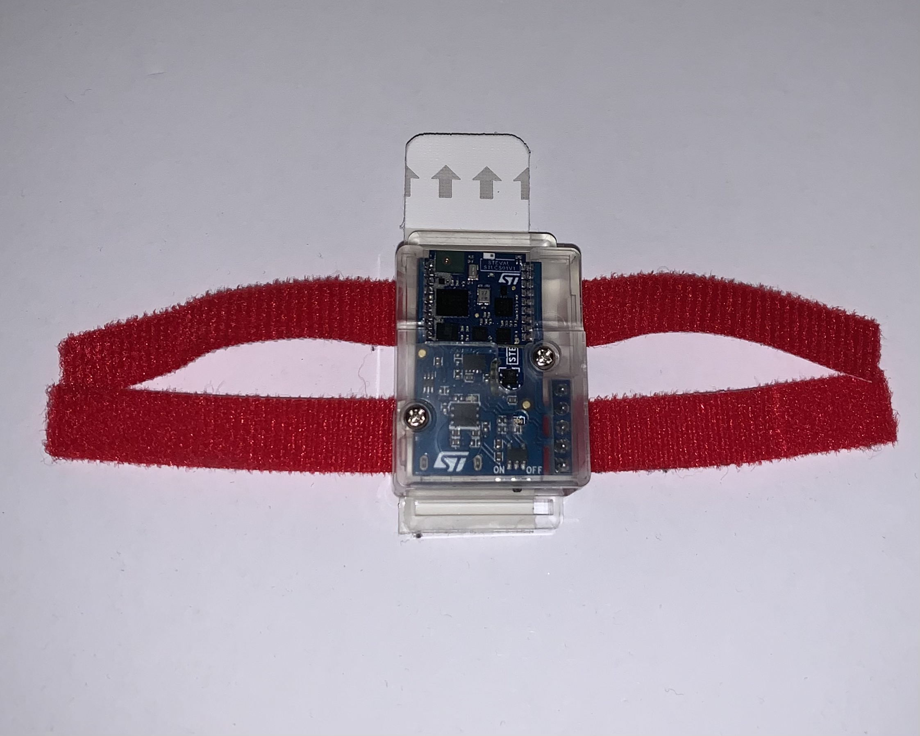
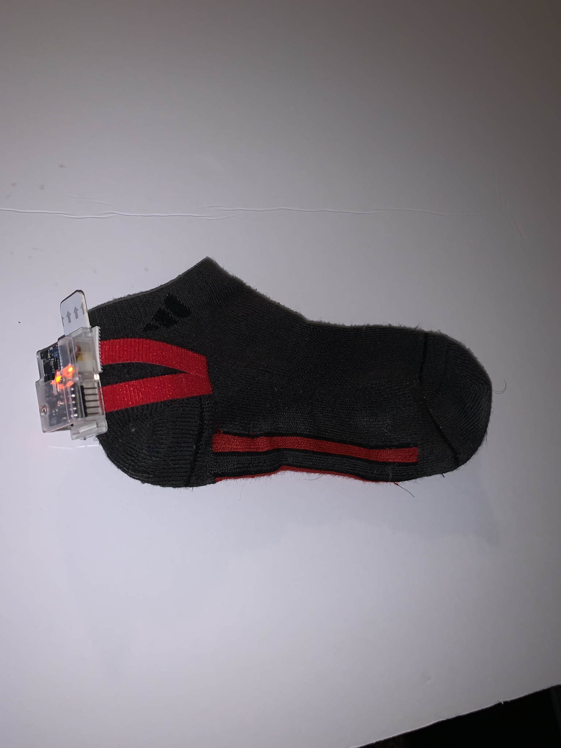
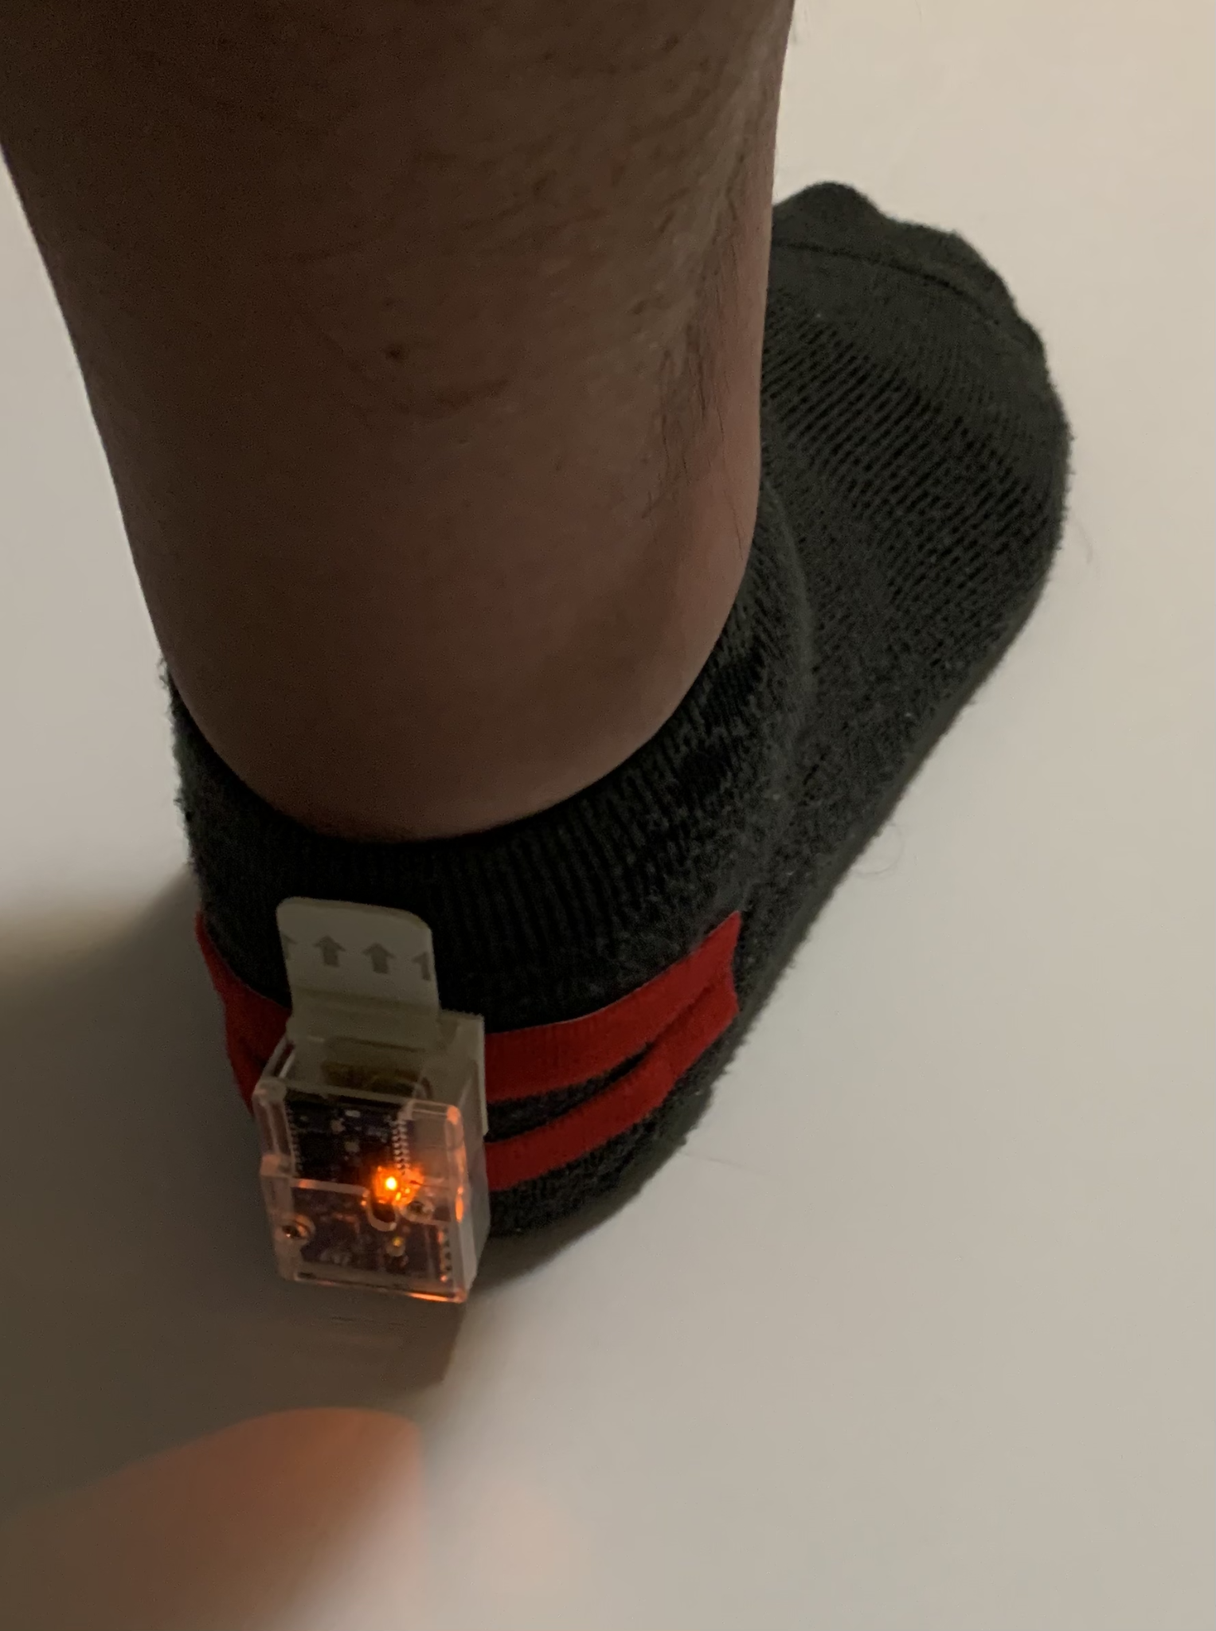
Sensor Tile Placement

Slide 4
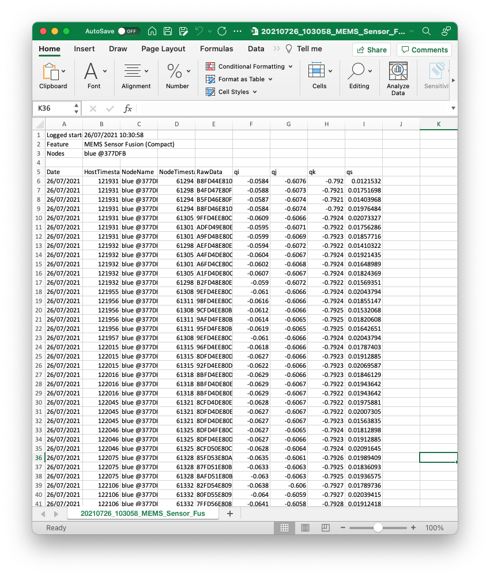
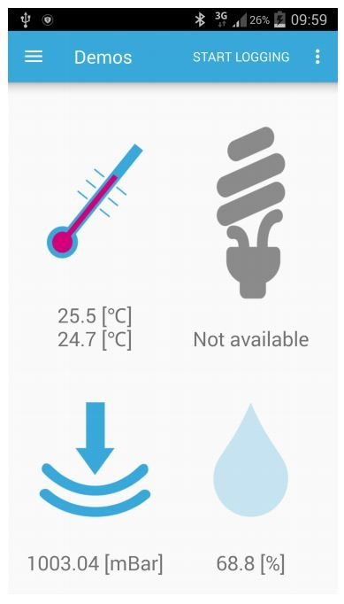


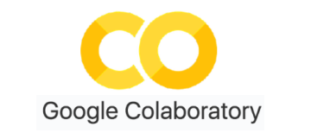
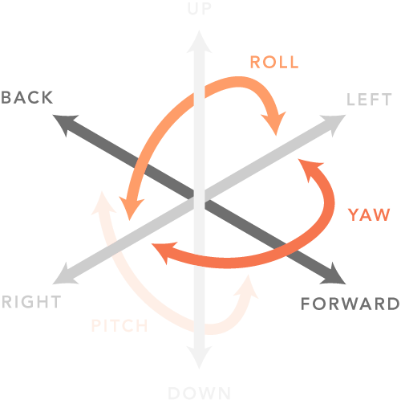
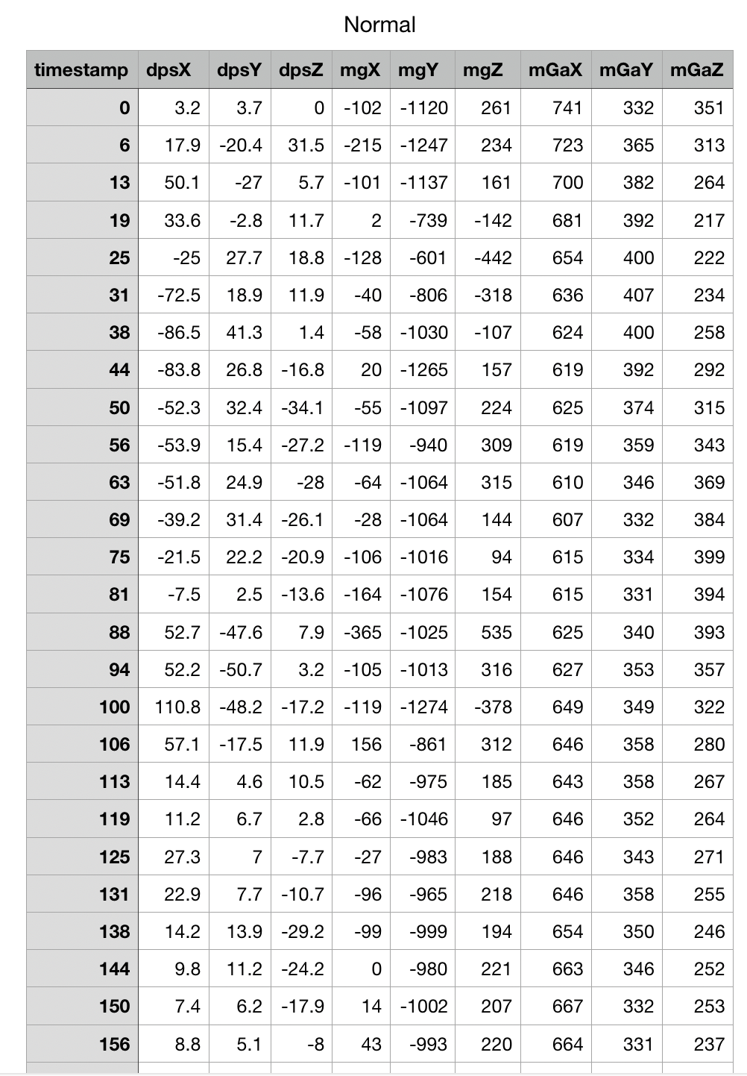


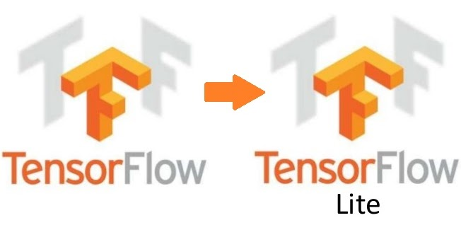
Data Capture
Strides
Stride CSV
Raw Data
Nomal
Pronation
OverPronation
Supination
Over Supination
Gyro
Accelerometer
Magnetometer
Clean Data

Slide 5

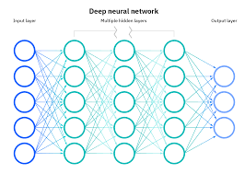

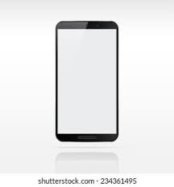
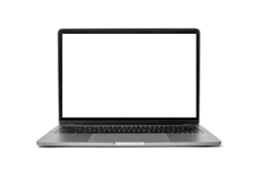
Data Processing
InferenceModeling
Model Deployment
Data Analysis
Filtering
Feature Selection
Model Selection
Training
Evaluation
Make predictions on the Tile Instead of sending live data

Slide 6
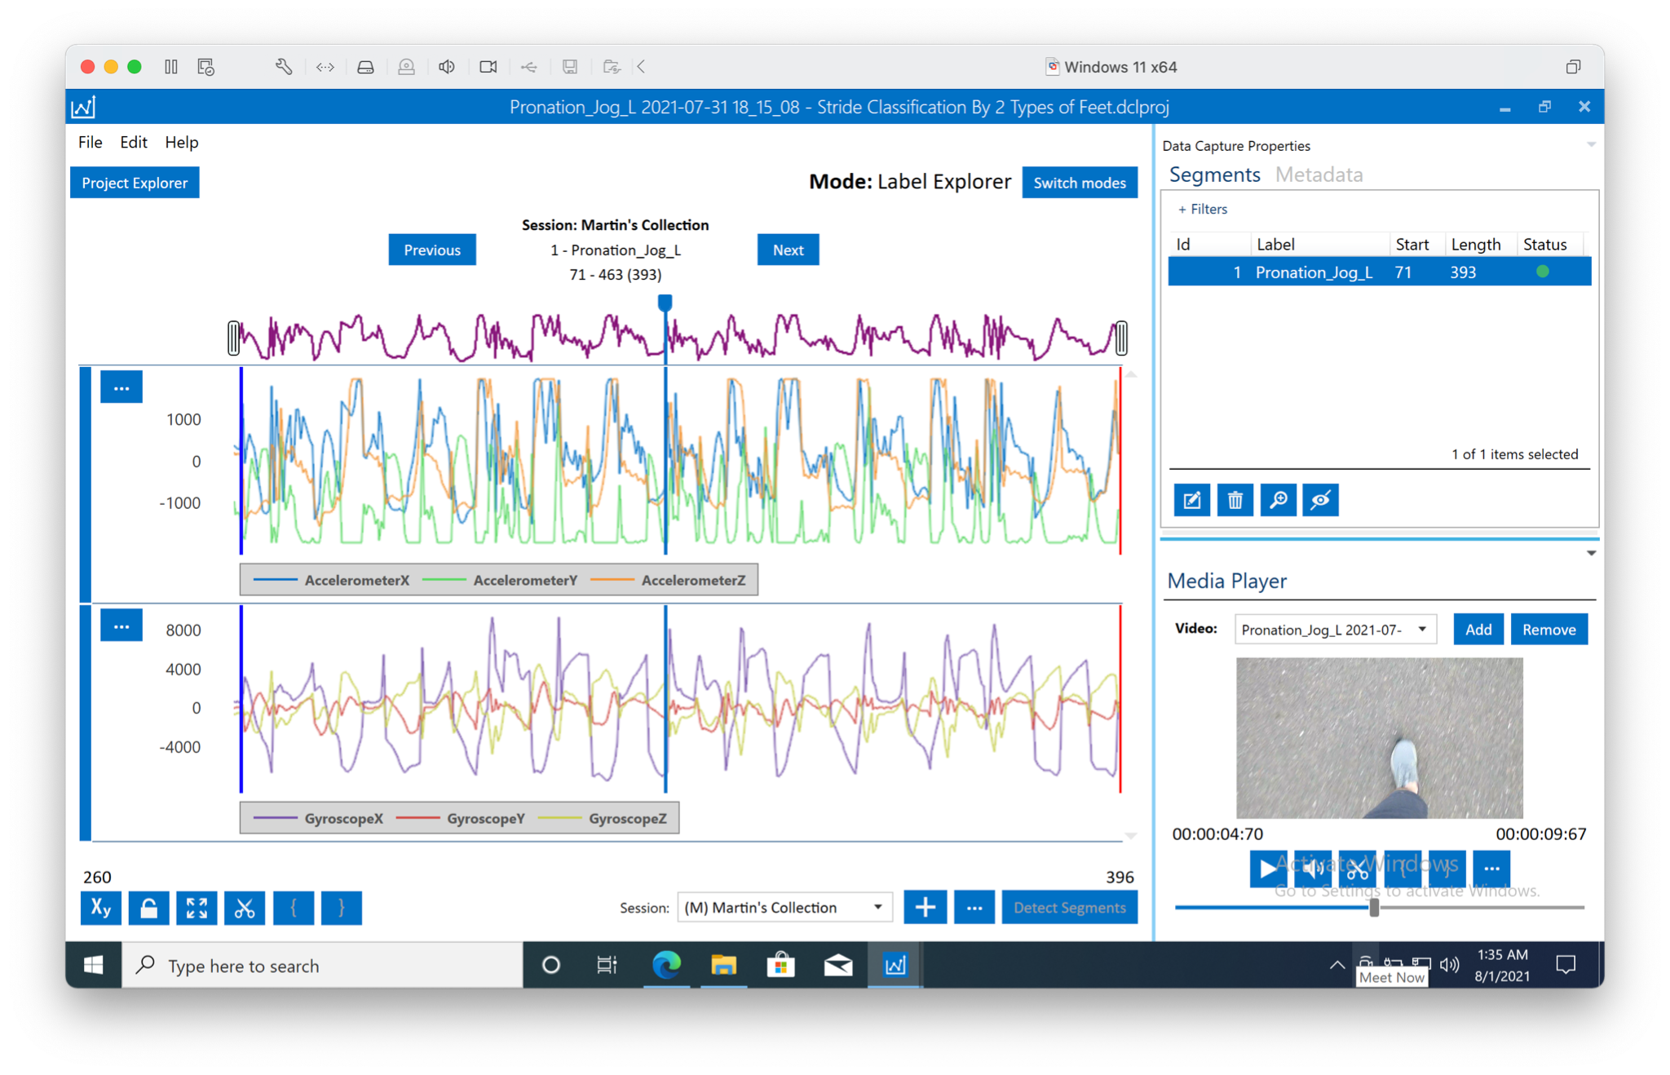
Data Collection

Slide 7
Data Analysis

Slide 8
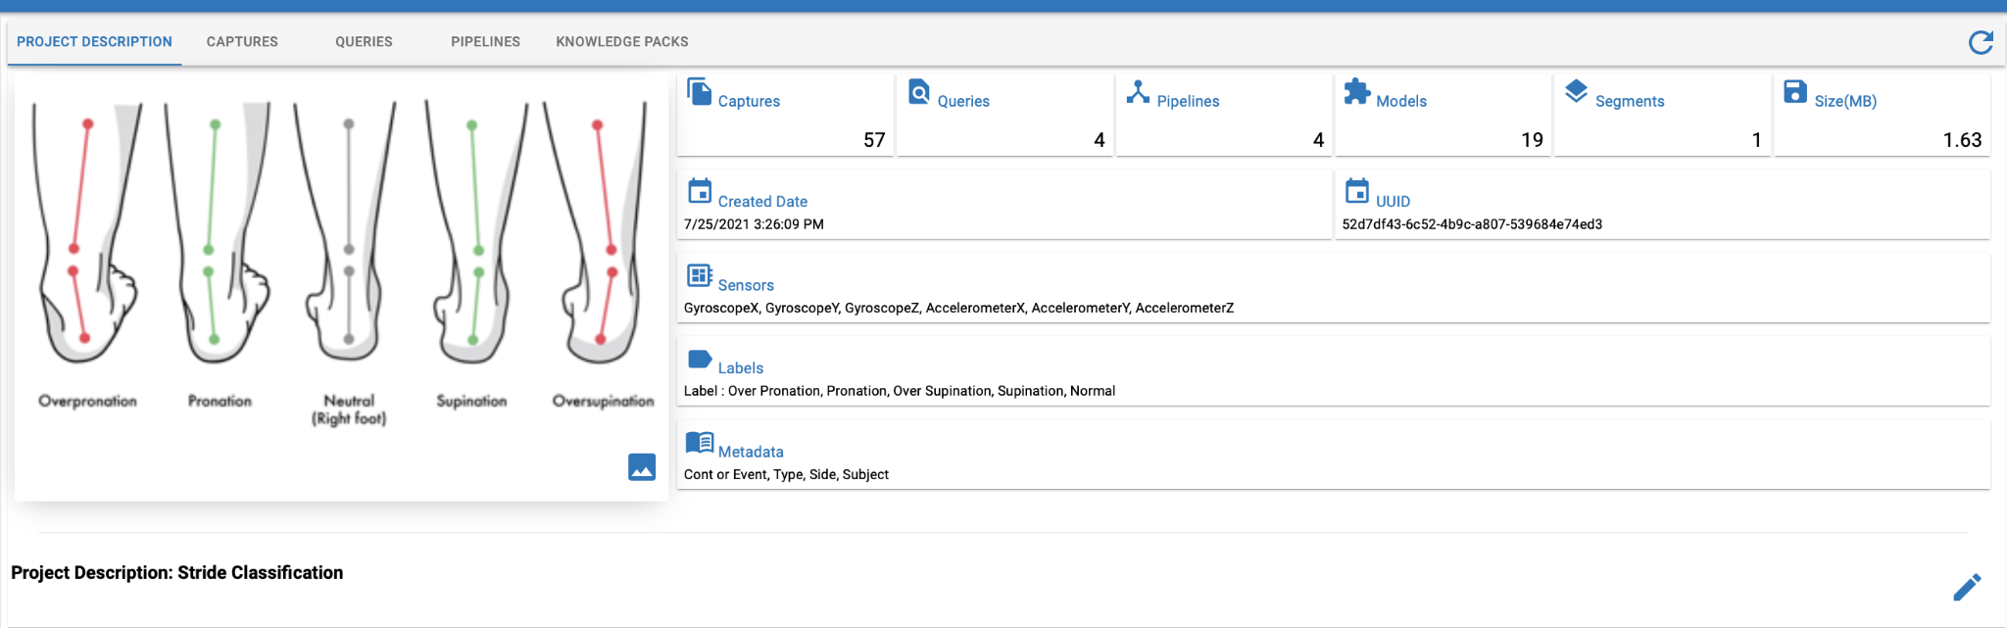
SensiML Project Summary
So far, we have:
Done 57 data capture sessions (Approx. 1.63MB)
Defined 4 Queries to separate the data
Created 4 pipelines
Fitted 19 models (Between 12 Bytes and 10 KB)

Slide 9
Models
The accuracy of the models range between 62% and 99%.
All of the models were created using the pipelines applied to the queried data.
Many of the models were created using the automatic functions for data processing, and automatic futures generation provided by the tool. The number of features generated range between 2 and 43.
The obtained models are :
PME - KNN, using RBF optimizer (3 to 9 Neurons),
Decision Tree Ensembles (Max deep of 4 5)
NN (Manually created, with 3 Dense layers and 195 params)

Slide 10
NN Models and SensiML
Using the automatic function, for features and model selection from SensiML, we were able to predict with a good accuracy, but below 90%,
in order to improve the accuracy and create NN models, coding in Python was necessary, using some functions of SensiMl as a library.
These were the steps we took to create our NN model:
Manually Added Features
Features added with Feature Generator
Significant Features Selected (reduced to a few)
Scaling the output data before training the model
Creating Train and Test Datasets
NN Model Architecture & Training
Quantizing the Model for TFLite
Uploading the Model Back to SensiML Project

Slide 11
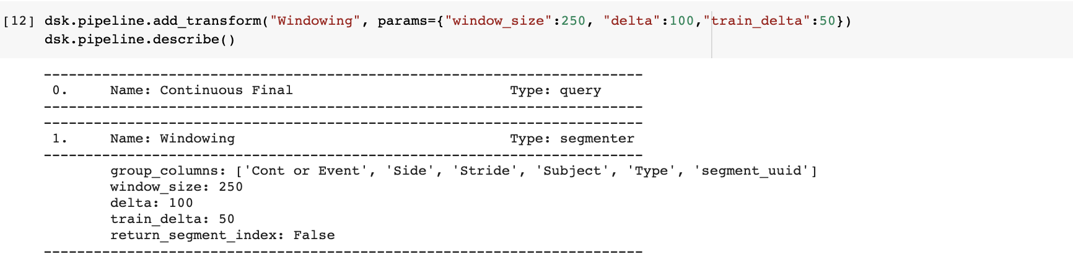
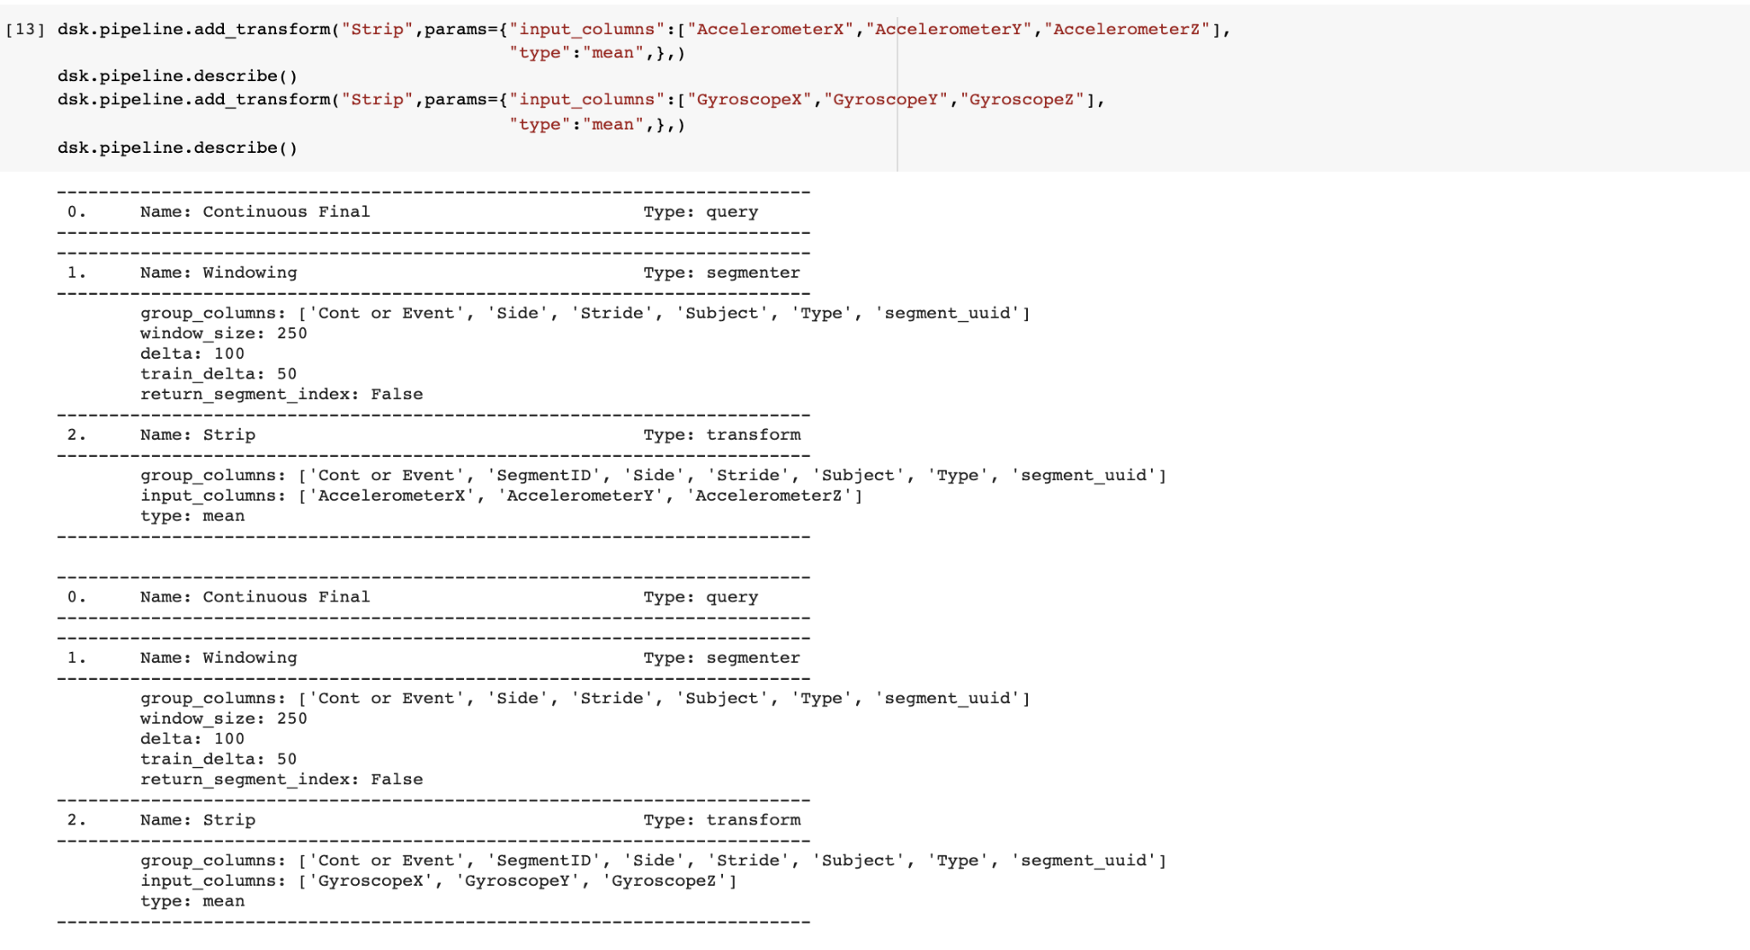
Manually added Features (Mean).
A windowing transformation with a window of 250 and a delta of 100 was used. Then the mean was calculated for all the existing sensor data columns.

Slide 12
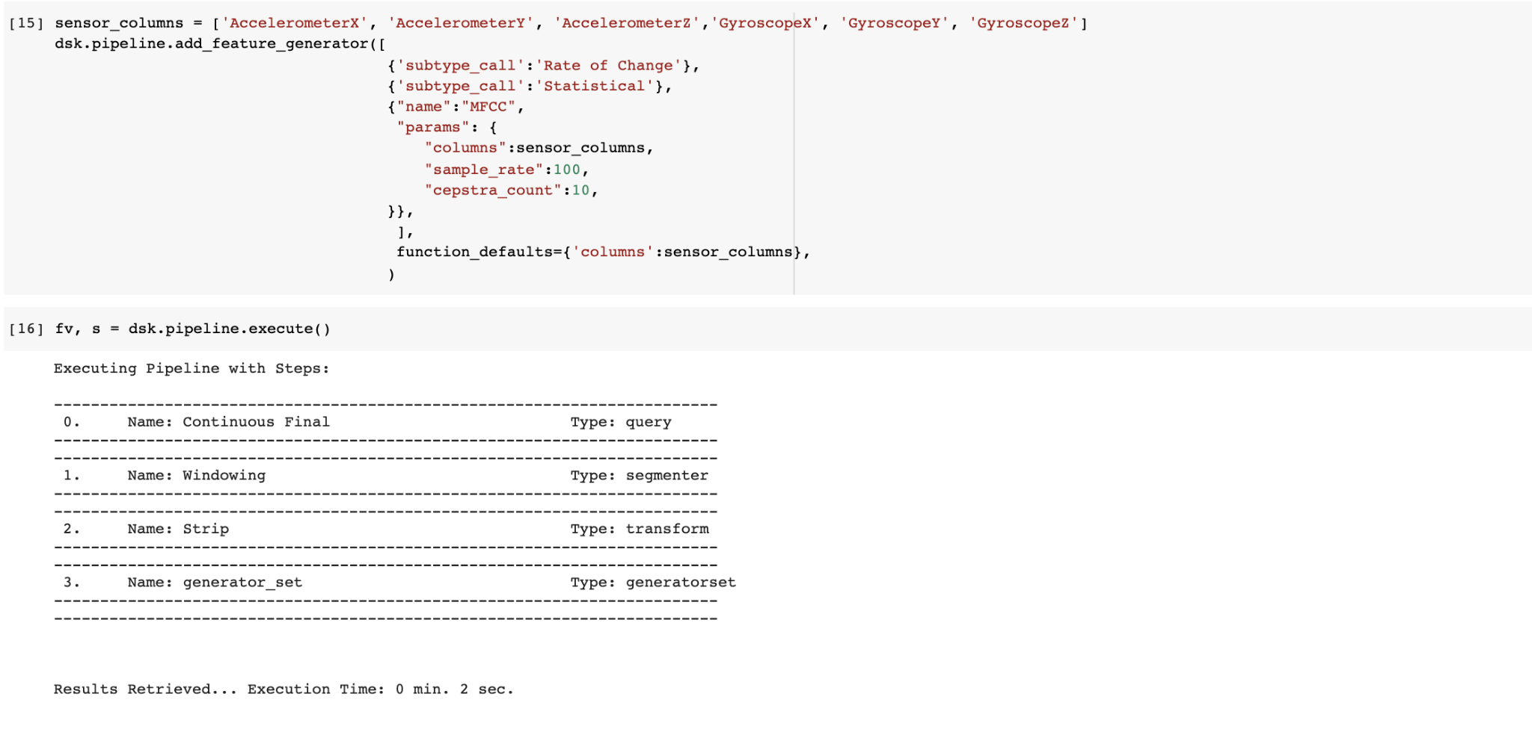
Features added with Feature Generator
Using 2 of the provided feature generators, Rate of Change & Statistical, we generated multiple feature variables, to a total of 246 columns.

Slide 13
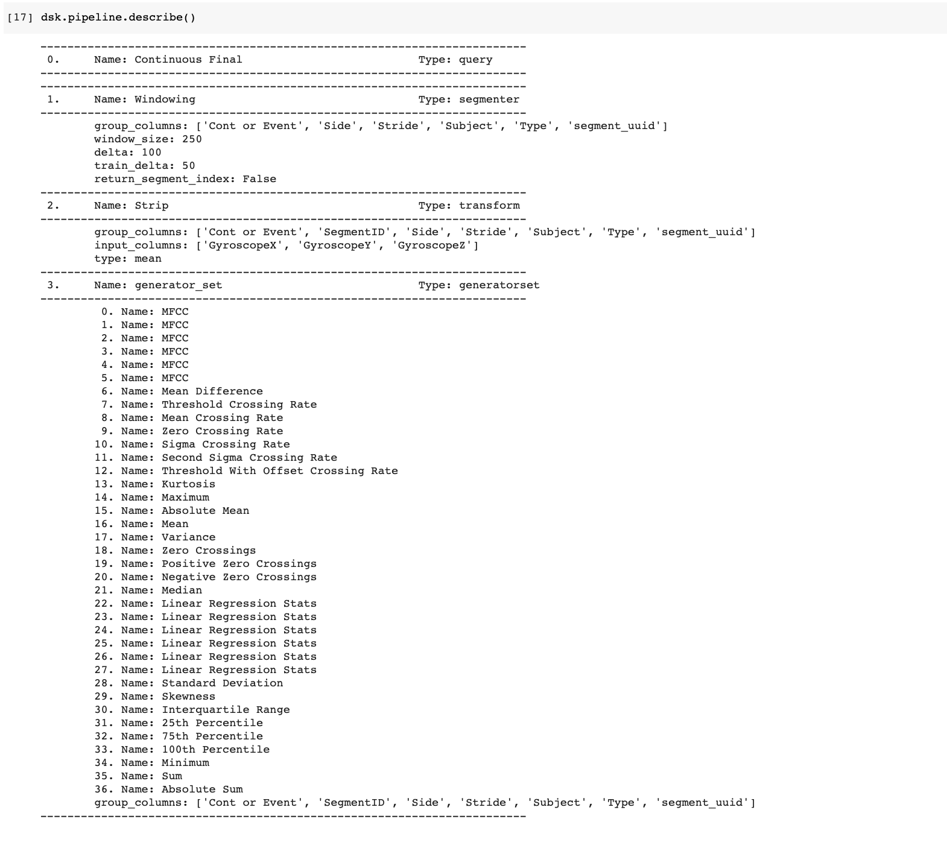
Features added with Feature Generator
Using 2 of the provided feature generators, Rate of Change & Statistical, we generated multiple feature variables, to a total of 246 columns.

Slide 14
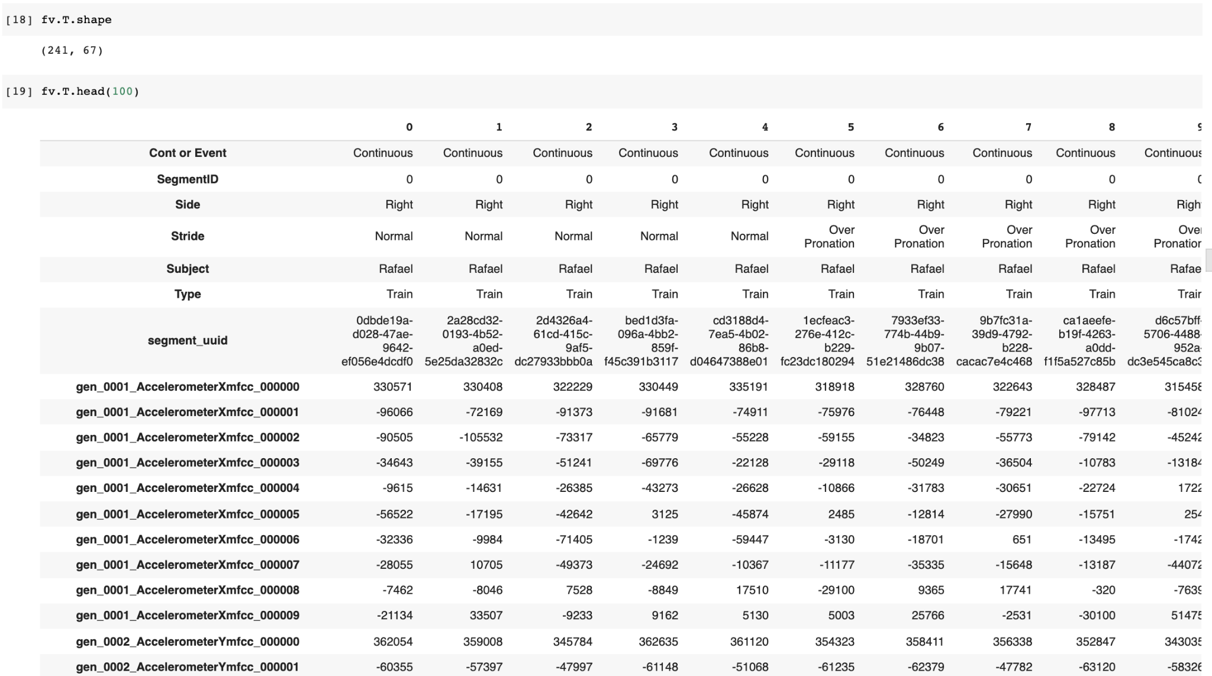
Features added with Feature Generator

Slide 15
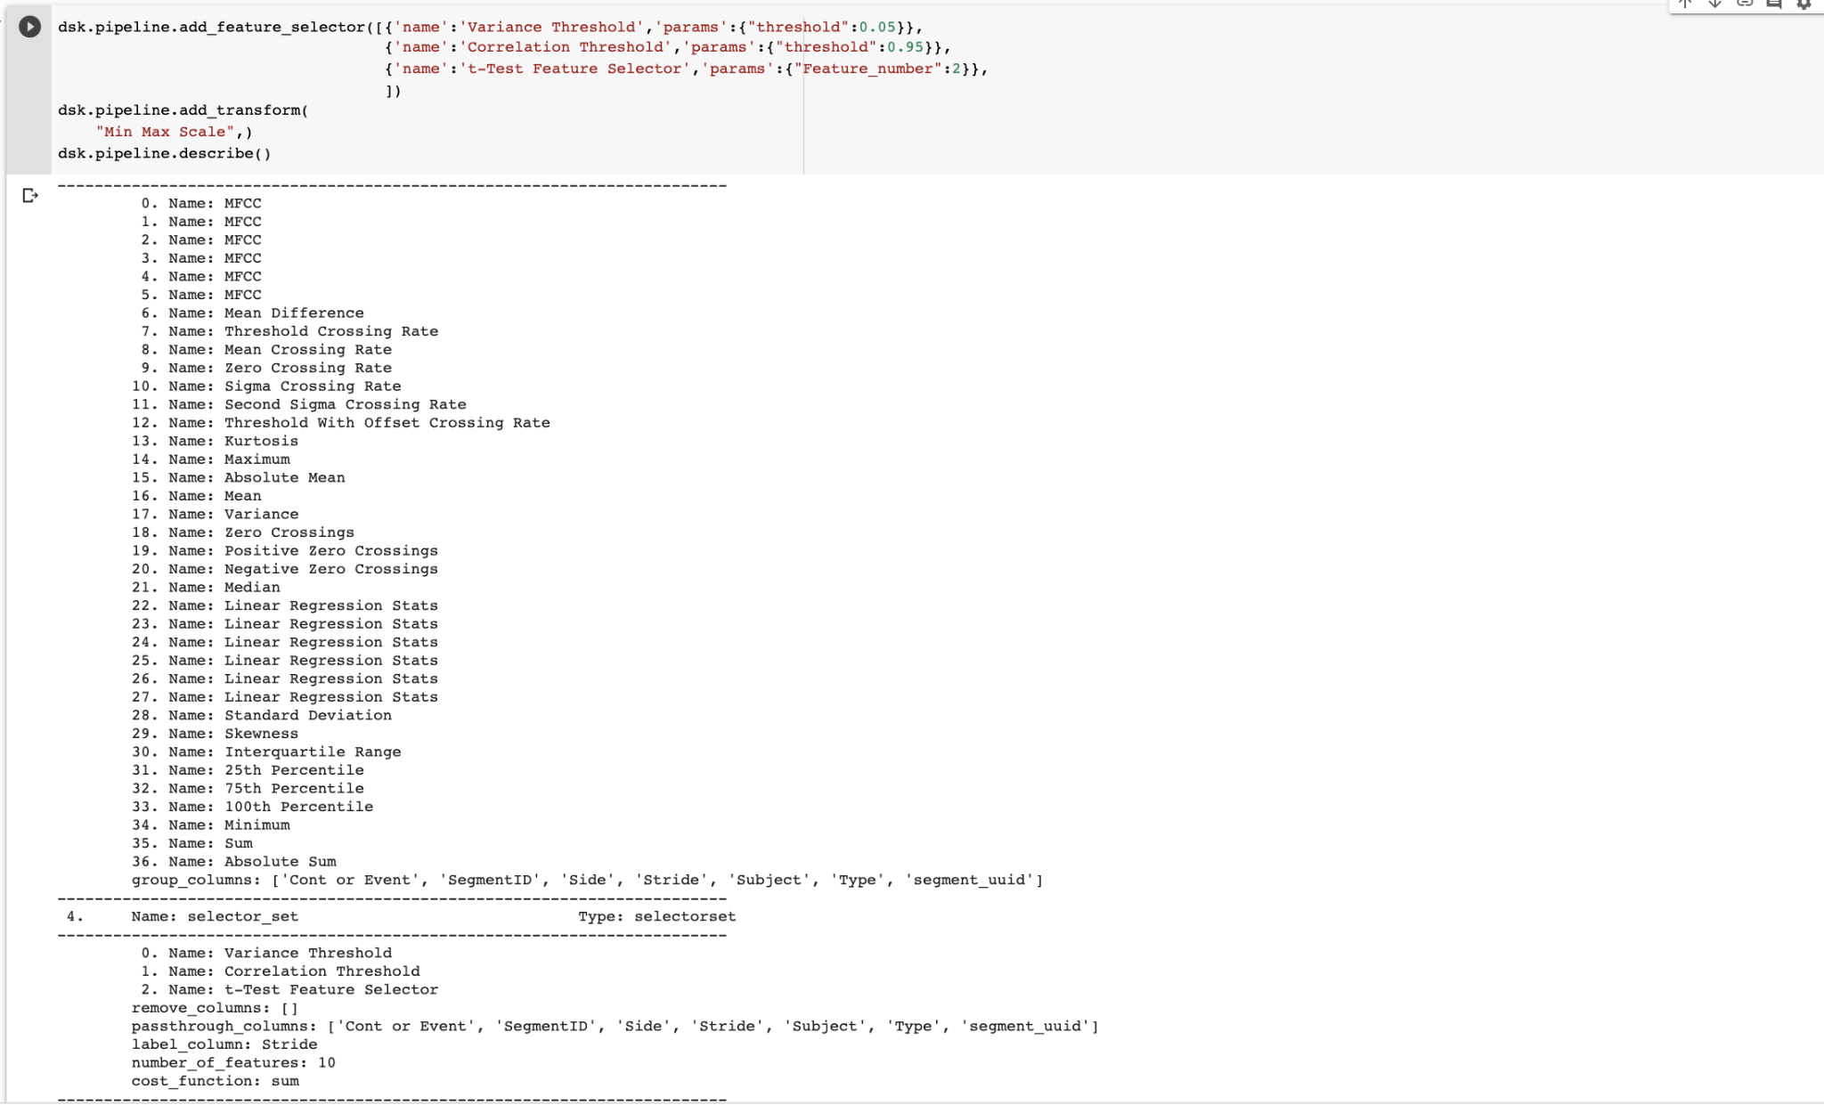
Feature Selection and Scaling the output data before training the model.
Feature Selection using:
Variance Threshold
Correlation Threshold
t-Test Feature Selector
Scaling the output data with Min Max Scale, before training the model.

Slide 16
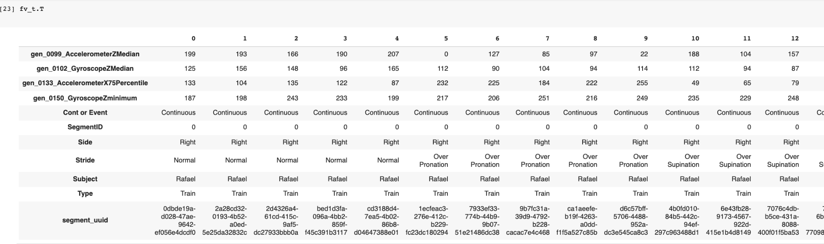
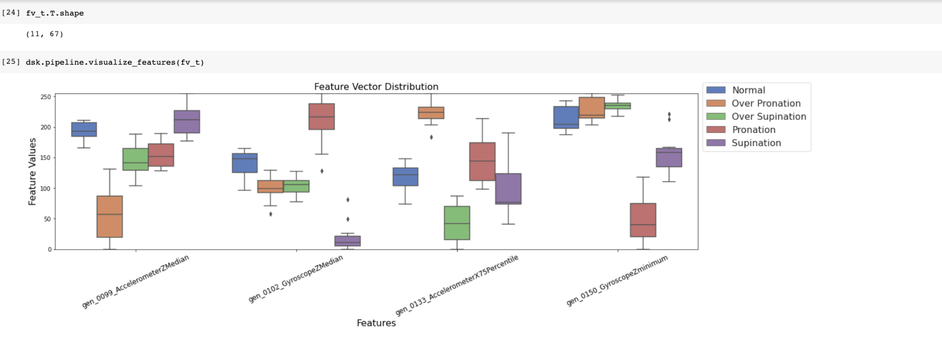
Significant Features Selected (reduced to a few)

Slide 17
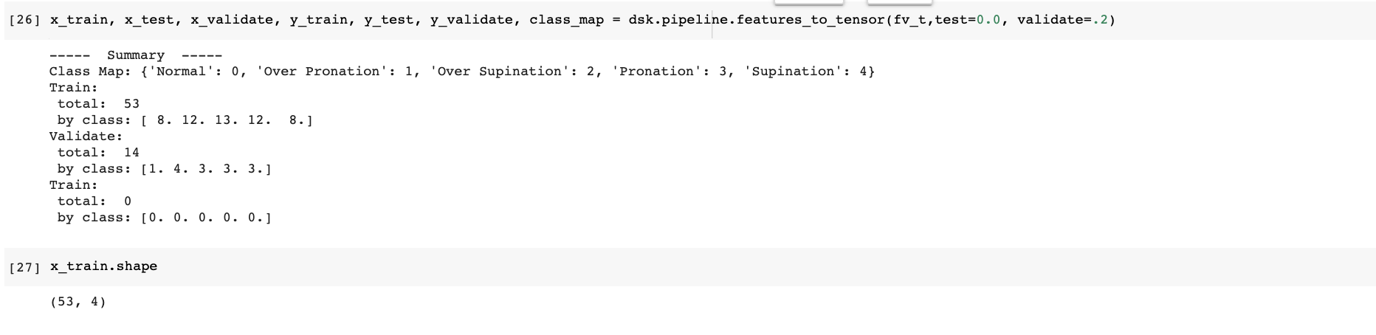
Creating Train and Test Datasets

Slide 18
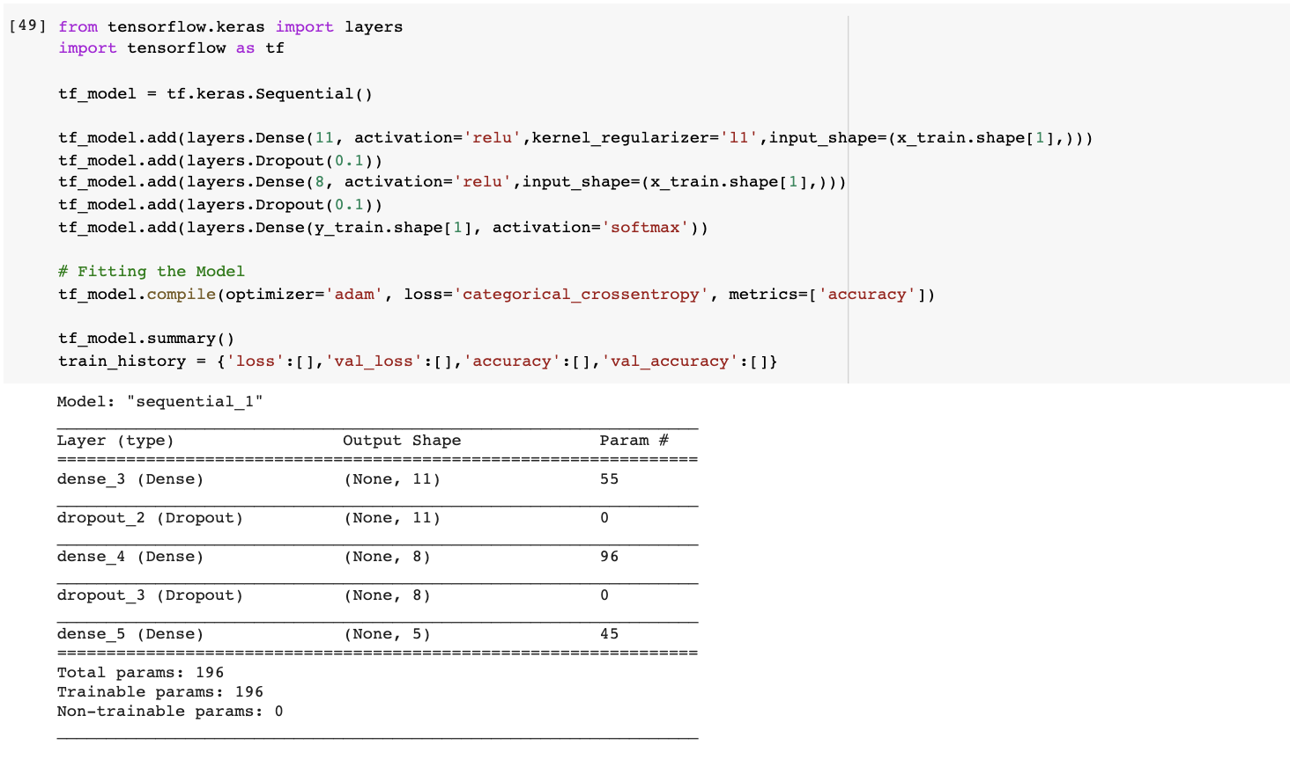
NN Model Architecture

Slide 19
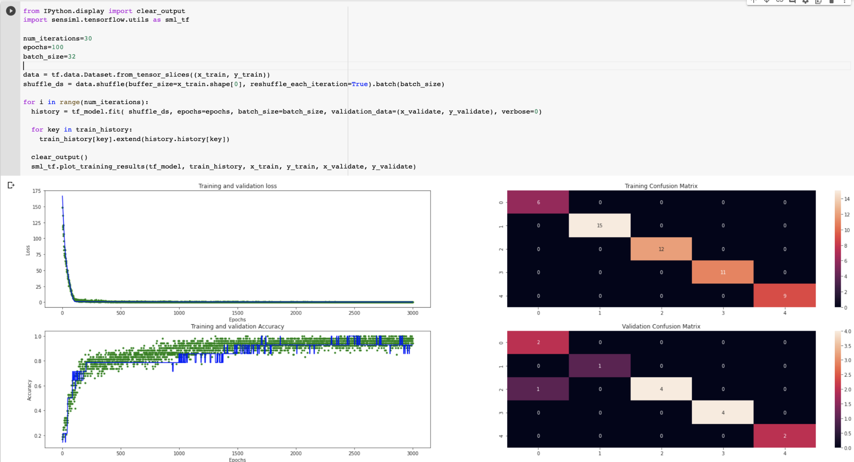
Training the Model

Slide 20
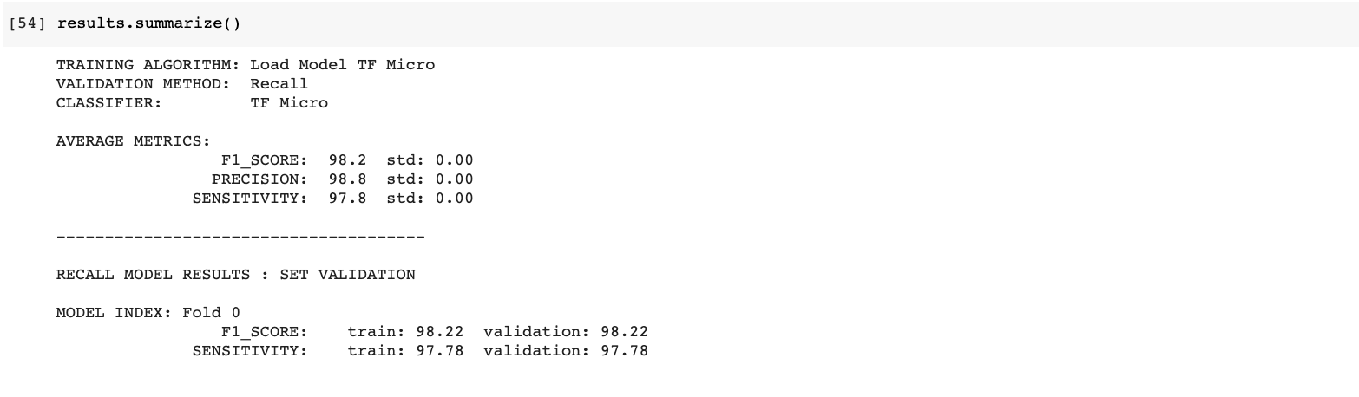
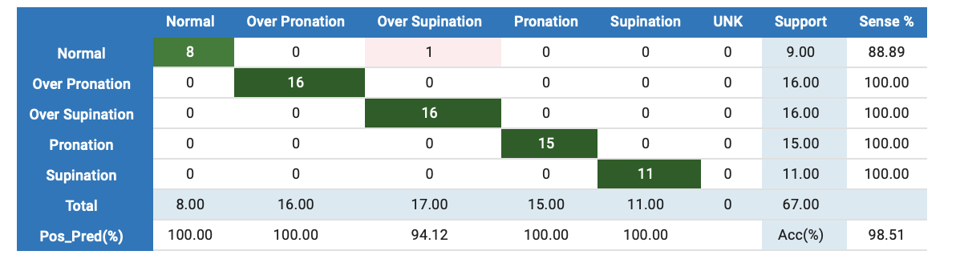
Model Accuracy

Slide 21
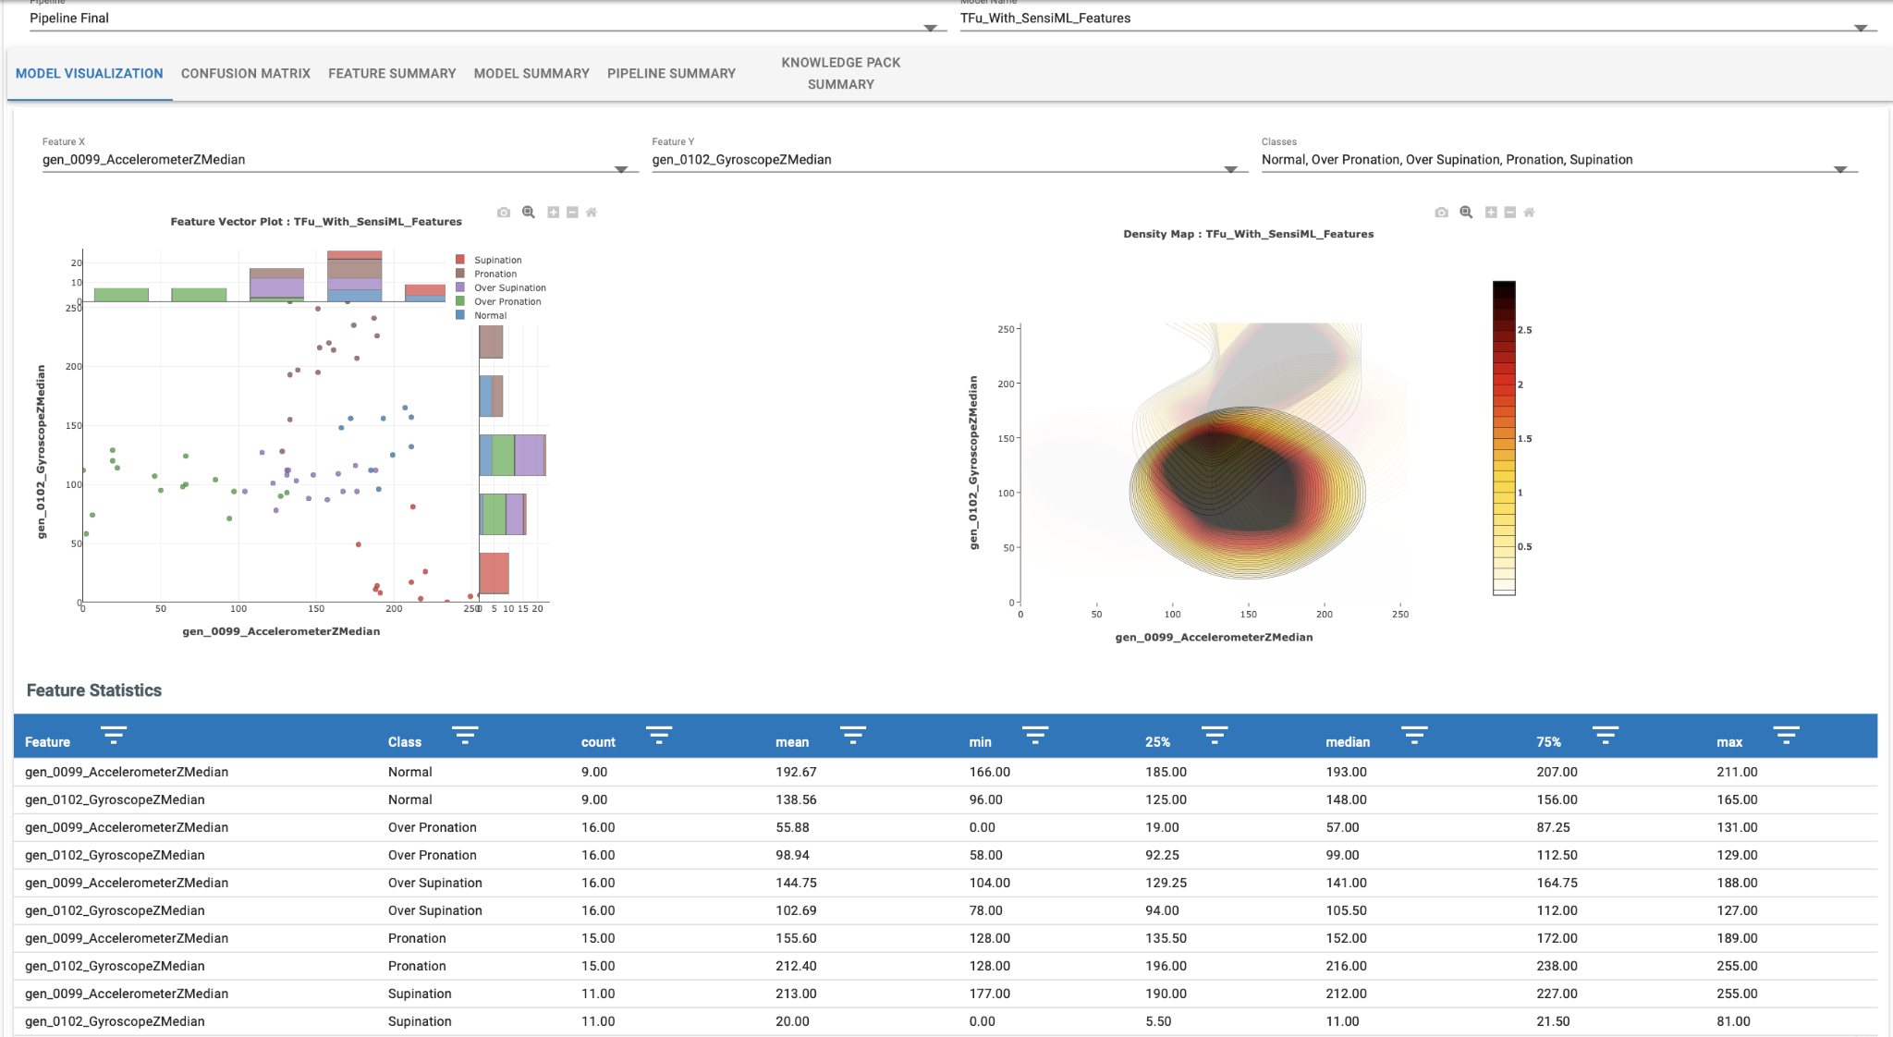

Slide 22
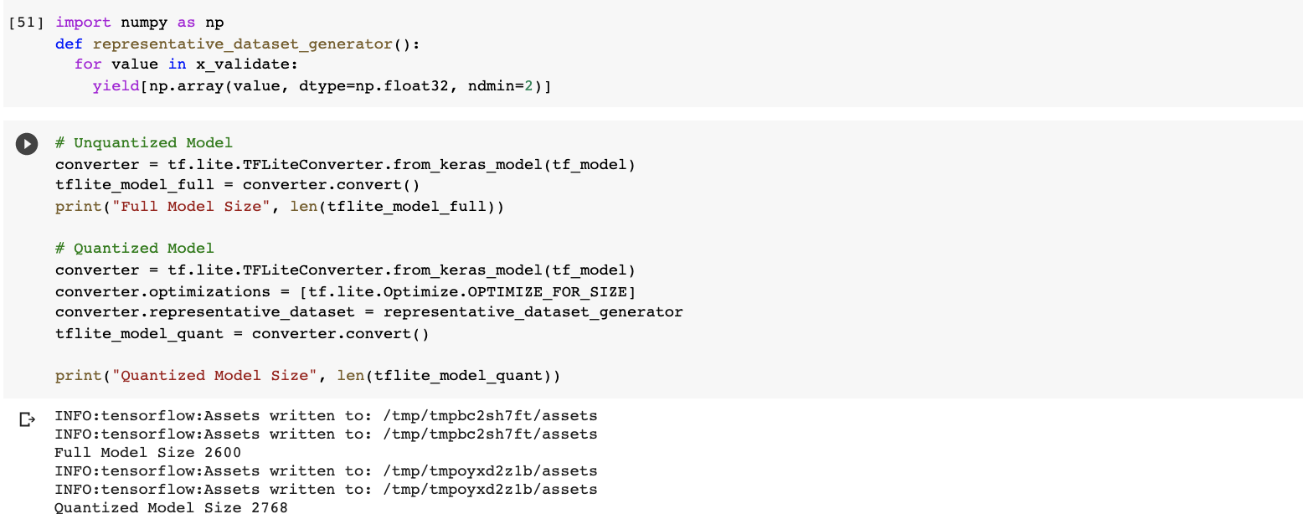
Quantizing the Model for TFLite

Slide 23
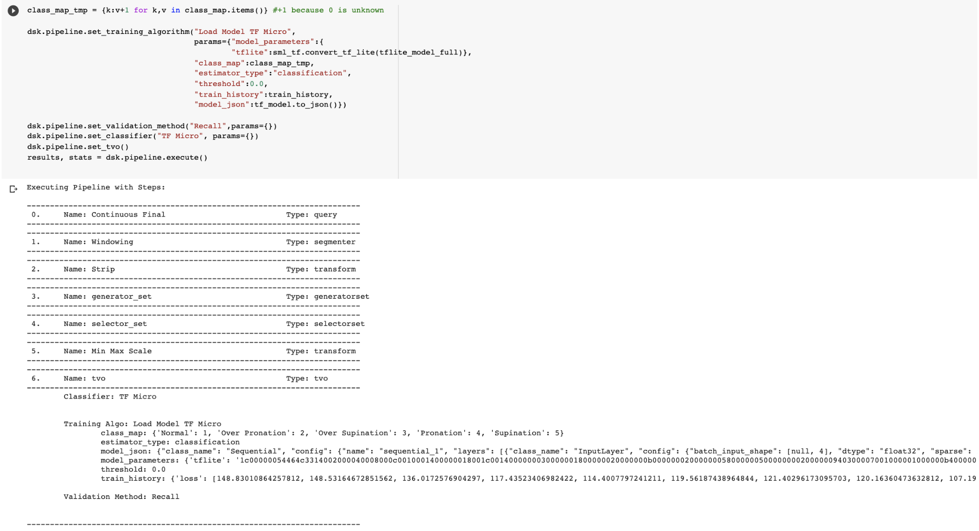
Uploading the Model Back to SensiML Project

Slide 24
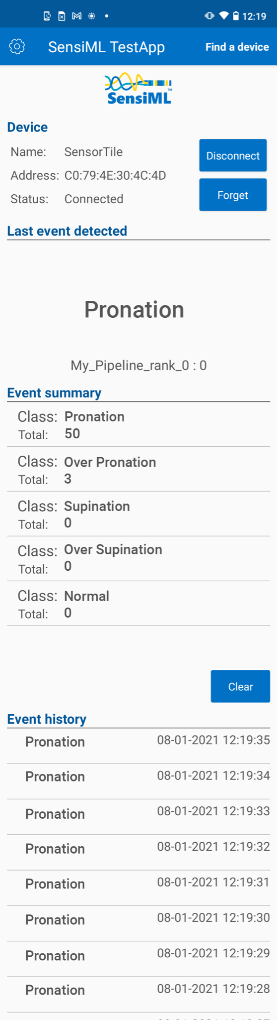
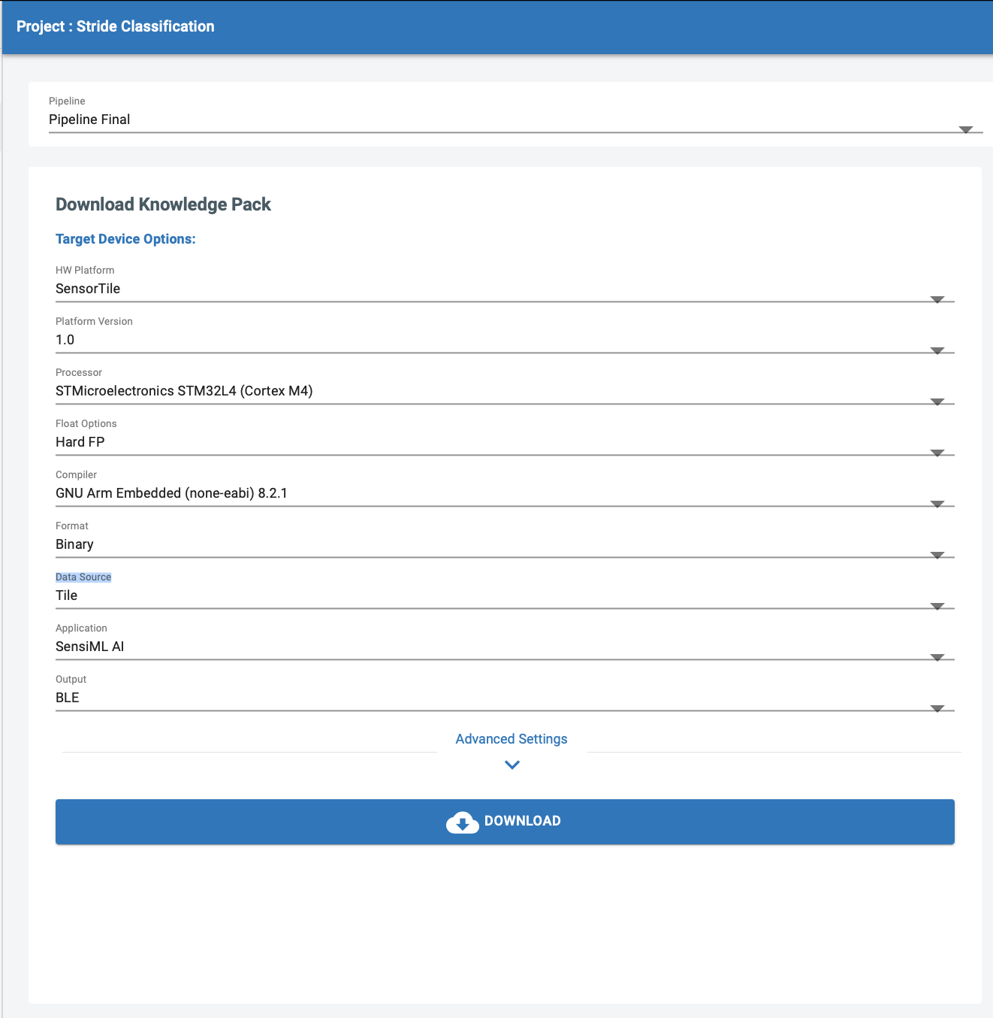
Deployment
Going from IDE to Android

Slide 25
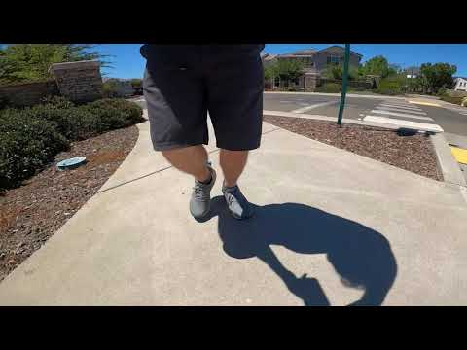
Video

Slide 26
Conclusions

Slide 27
References
Mayo Clinic. “Running - Mayo Clinic Orthopedics & Sports Medicine.” Running - Mayo Clinic Orthopedics & Sports Medicine, 2021, https://sportsmedicine.mayoclinic.org/service/running/. Accessed 25 7 2021.
Mayo Clinic. “Flat Feet Treatments.” Flatfeet - Diagnosis and treatment, 2021, https://www.mayoclinic.org/diseases-conditions/flatfeet/diagnosis-treatment/drc-20372609. Accessed 25 7 2021.
Association for Computing Machinery. “Smart insole: a wearable system for gait analysis”, Conference Paper, 2012, https://dl.acm.org/doi/10.1145/2413097.2413120. DOI: 10.1145/2413097.2413120, Accessed 7 25 2021.
W3C. “About W3C.” https://validator.w3.org/about.html, 2021,
https://validator.w3.org/about.html. Accessed 7 25 2021.

Slide 28
Links
Final Report in Google Docs:
https://docs.google.com/document/d/17RcKpGCK8gkb1wyRmNkTXA7NZOqp3j9zShf3wMb5xG8/edit?usp=sharing
Project Presentation in Google Docs:
https://docs.google.com/presentation/d/1J446wwsRWfFNJ151eCp1U2G-3nKs7uOY9QrBzNaMDK0/edit?usp=sharing
Demo Video in Youtube:
https://youtu.be/eZLqpIjwU2s
GitHub Project Repository:
https://github.com/rafah1/Walking-Stride-Classification

Slide 29
Thank You!

